Slide 1

Bite Sized Umpiring
Understanding Playing Regulations
Slides will build up for you
To move to next slide click your space bar

Slide 2
This series of short clips and slides aims to:
Jog a few memories for established umpires
To give a few tips to the less experienced
Maybe give players, and especially captains, a few ideas about what they should be looking for when they come to mark an umpire’s performance as many are asked to do on a weekly basis
Provide some food for thought and hopefully some light relief for the viewer
Press your space bar for the next slide

Slide 3
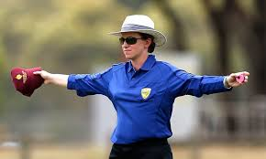
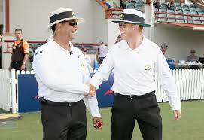
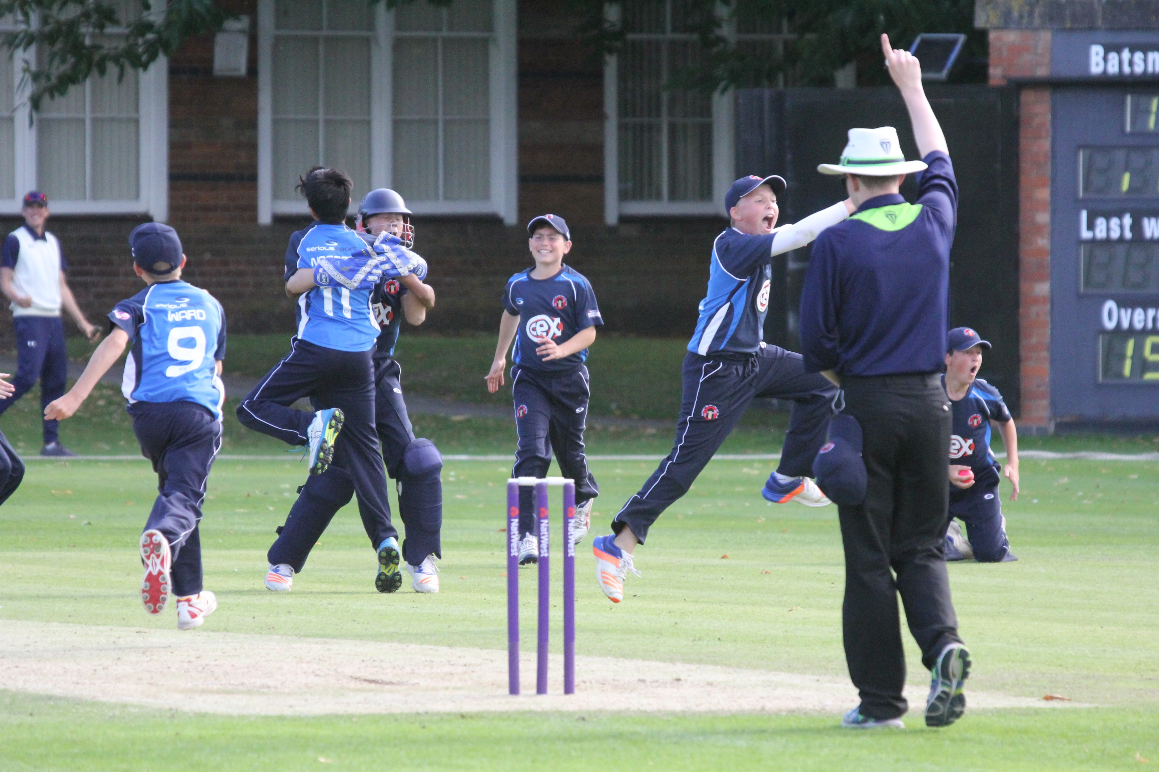
These presentations are an overview only
They will provide you with an understanding of some cricket umpiring techniques, but you will need to develop these skills through practical experience and more structured training should you wish
It won’t teach you everything you need to know, but it will give you some of the tools to start off
Press your space bar for the next slide

Slide 4
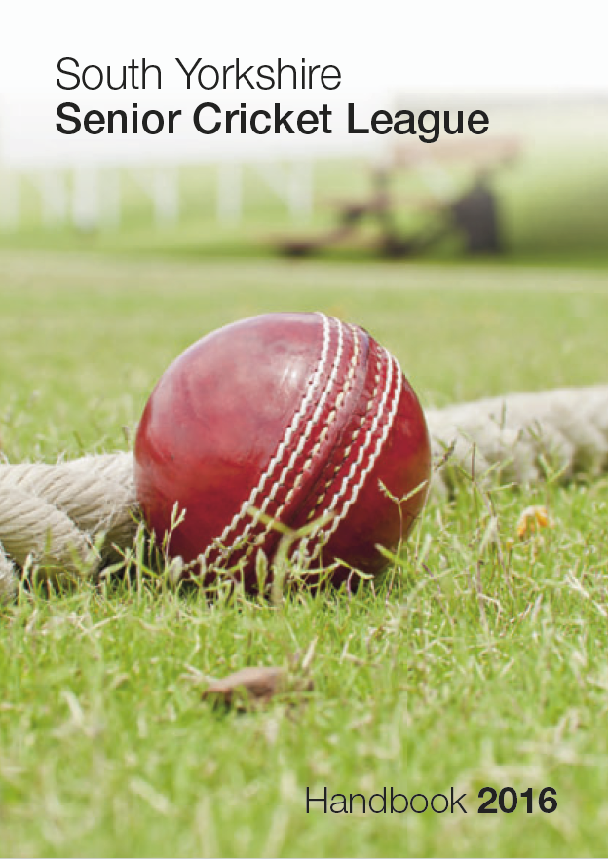
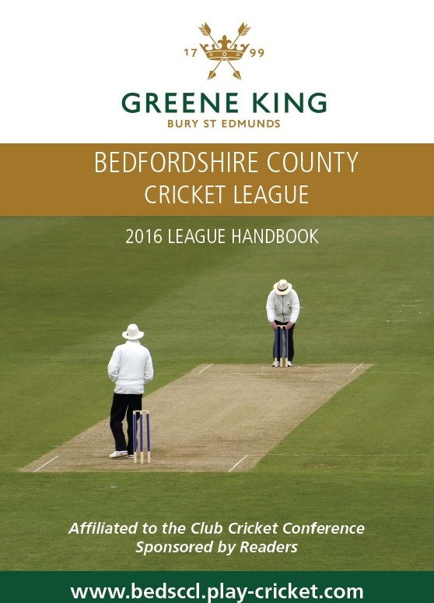
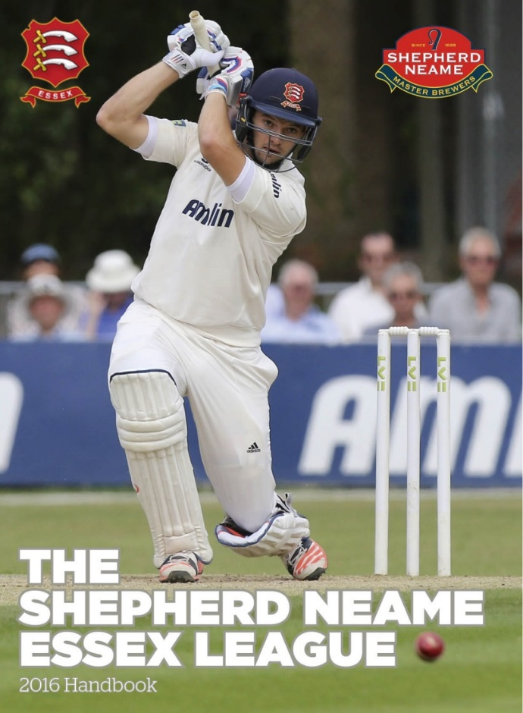
Understanding Playing Regulations
Strange as it may seem, very little cricket is played solely to the
MCC Laws of Cricket
Press your space bar for the next slide

Slide 5
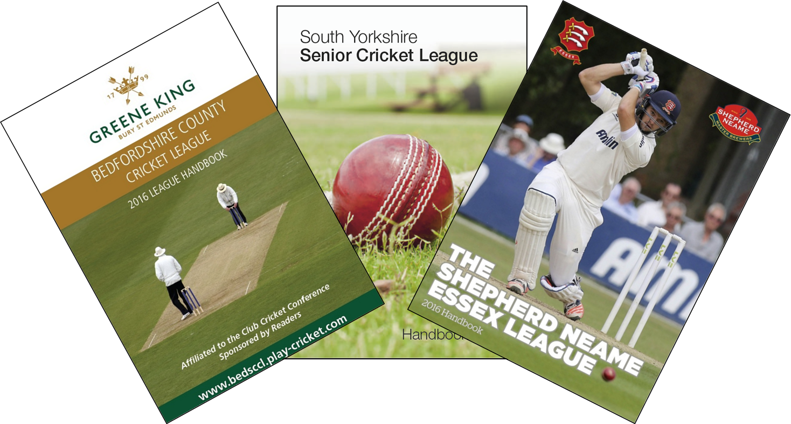
In the pages of these league books, and most others like them, the notes relating to how the game is played
start with something like:
“The Laws of Cricket shall apply except as set out below:”
In other words the “Regulations” override the “Laws” in many cases
Press your space bar for the next slide

Slide 6
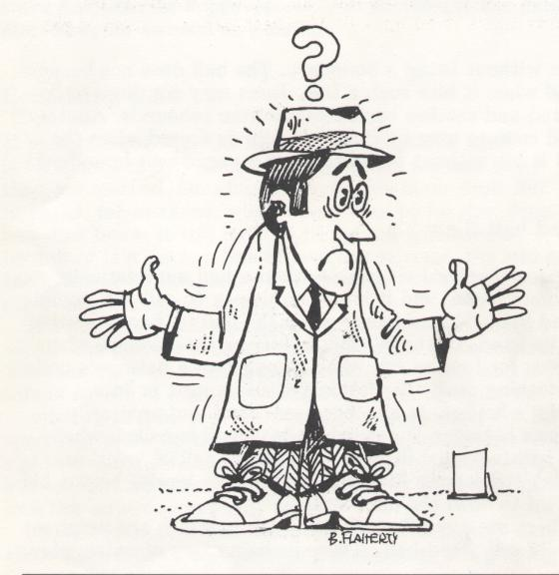
The problem for umpires is that there are as many sets of “regulations” as there are leagues and competitions…..
…. and a major gripe that comes across ECB ACO desks is that “the umpires didn’t know the regulations.”
No doubt the captains didn’t either and only found out about any error later but that doesn’t count of course!
Press your space bar for next the slide

Slide 7

The wide variation in regulations is especially true in some Junior competitions
No Balls and Wides are not re-bowled unless in the final over(s)
Batters retire and resume their innings.
If you open the batting you can’t bowl until a certain stage of the innings
Power Plays occur in weird and wonderful places
Coaches can call “Time Out” drinks breaks
Press your space bar for the next slide

Slide 8
ECB Young Player Directives
Umpires must also ensure that these Directives are followed as they override both the Laws and Playing Regulations
Fast bowlers’ spells and total overs are dictated by these Directives not Regulations
(This can take some careful management by the captain to ensure a young fast bowler can complete his overs allotted by Regulation, whilst complying with the ECB Directives)
Fielding restrictions for young players need to be taken into account as well as those within any Power Play Regulations
(e.g. If close catchers are required)
Wearing of helmets also needs to be observed
(An U18 player acting as a runner must wear a helmet even if the player he is running for is not wearing one)
Press your space bar for the next slide

Slide 9
It would be impossible to go through all the regulations here, but in this presentation but we will attempt to point out the main areas of concern and what you should be looking out for when preparing for a game in a different competition to your usual Saturday afternoon.
(Where we will assume you know the regulations??)
This presentation is based around a document kindly provided by Middlesex ACO
Press your space bar for the next slide

Slide 10
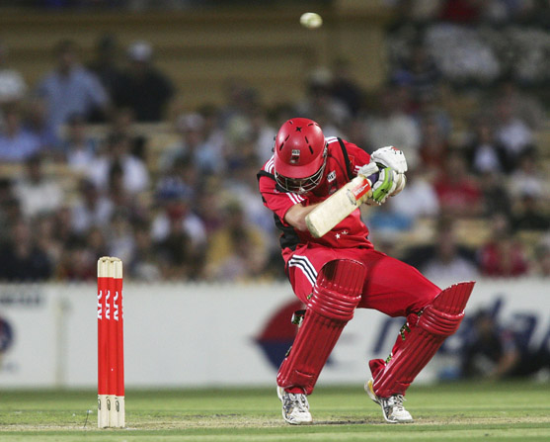
Playing regulations may override the Law
For example, in many ICC competitions there is a regulation that calls an over head height bouncer as a Wide whereas Law 21.10 says it’s a No Ball.
In this case Law 21.10 is overridden.
(See Bite Size module on Bouncers)
The moral of the story is – “Just because you saw it on telly doesn’t mean that’s what we’re playing today”
Press your space bar for the next slide

Slide 11
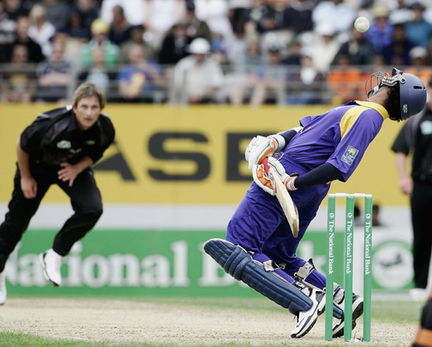
Conversely, you will often find a regulation that permits only one or two over shoulder height bouncers per over.
In this case, the provision is in addition to and does not override Law 41.6. (Bowling of dangerous and unfair short pitched deliveries)
If you consider the delivery dangerous you must still invoke the sanctions in Law 41.6 even if it is one of those “allowed” in the over
Press your space bar for the next slide

Slide 12
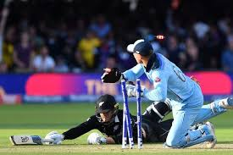
Other areas of potential problems – The Result
Most cricket is limited overs - Who scores most runs wins
But what if the scores are level?
Does it go on wickets lost?
Super over?
Countback to penultimate over?
Countback to Power Play overs?
Is it a “Tie”?
As the umpires, you MUST know how the result is decided before the game starts
Press your space bar for the next slide

Slide 13
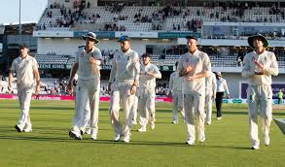
Other areas of potential problems – The Result
In Timed games you also have the options of a Draw and a Tie
But even that may be further complicated by such things as “winning draws” depending on run rates or other considerations.
Thankfully, that is usually more of a
problem for the scorers than the umpires…
But you still need to be aware of it and the pressures that it might bring.
Press your space bar for the next slide

Slide 14
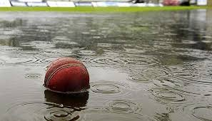
Simpler(?) matters – Limitations on overs
In “Limited Overs” games this will be stated as how many overs per innings…
… and probably how many overs per bowler –
BUT!
How does that change if you have to start late?
Is there any “golden time” where you don’t lose overs?
At what rate do you lose overs?
What if there is an interruption after you have started?
What if there is an interruption in the second innings but not in the first?
Are there a minimum number of overs to constitute a game?
Press your space bar for the next slide

Slide 15
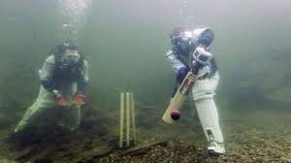
Any or all of these will probably need the umpires to calculate:
Overs lost
Bowler’s allocations
Fielding restrictions/Power Plays
Adjustments to intervals
Finishing times for each innings
Is there an over’s leeway in reduced games?
Target score for a result
– and, if you are really lucky – DLS! (But we might leave that last bit to the scorers!)
Press your space bar for the next slide

Slide 16
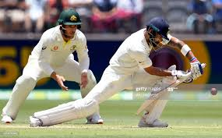
Simpler(?) matters – Limitations on overs
In Timed Games there may well be limitations on overs as well
– but often not an even split – for example:
120 overs in the game, first innings maybe limited to 64 overs.
If they are all out or declare before 64 overs do the side batting second get the balance?
If there is an interruption
how do you reduce the overs?
How many overs constitute a game?
Press your space bar for the next slide

Slide 17
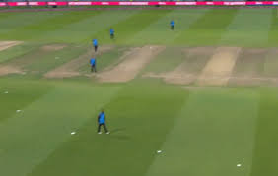
Fielding Restrictions (Power Plays)
Are there any Power Plays?
When do these occur – set times or chosen?
How are they applied – how many fielders and where?
What additional fielding restrictions apply? (e.g. no more than 5 on leg side)
Do the fielding restrictions involve fielding circles?
Which umpire is responsible for identifying breaches?
What are the sanctions?
What happens if the umpire fails to notice a breach?
(Can sanctions be applied retrospectively?)
Press your space bar for the next slide

Slide 18
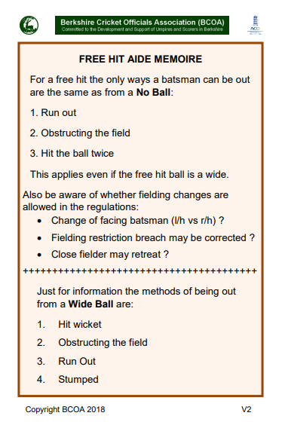
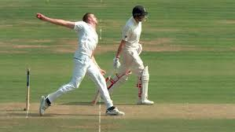
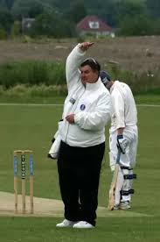
No Balls
How many runs added for a No Ball?
Is additional ball NOT delivered?
Is this the same in the last over?
Are there Free Hits?…
…for all No Balls or just foot faults/front foot only?
Are field changes permitted for a Free Hit
(if change of striker or not)?
How can a batter be out off the next delivery?
(maybe make a crib card)
Press your space bar for next slide

Slide 19
Wide Ball
How many runs added for a Wide Ball?
Is additional ball NOT delivered?
Is this same in last over?
Are Wide Ball crease markings required?
What are the regulations for an off side wide?
What are the regulations for a leg side wide?
Press your space bar for the next slide

Slide 20
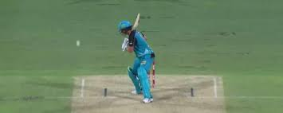
Wide Ball
Regulations on Wide Balls are so many and varied it is impossible to cover all the angles here.
(Pun completely intentional!)
Basically they are:
Laws of Cricket
Guidelines in the creases
“Profile” wides on leg side
Everything down leg side
(and variations on all of these)
It is vital to your control of the game that you know the wide regulations and apply them consistently
Press your space bar for the next slide

Slide 21
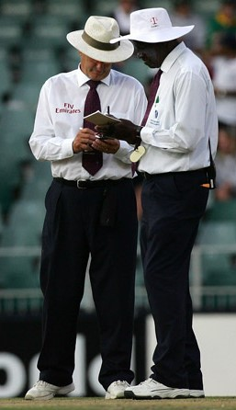
How to keep track of all these Regulations?
Many umpires will make up a card or “aide memoire” (crib / cheat sheet!) for each competition.
Review it, and the full regulations, the night before the game.
Review it again with your colleague at the ground
Make sure you agree what the regulations say
Have a copy of the full regulations in your bag (especially for rain calculations!)
Press your space bar for the next slide

Slide 22
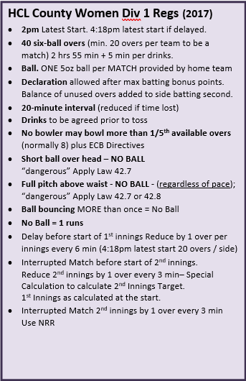
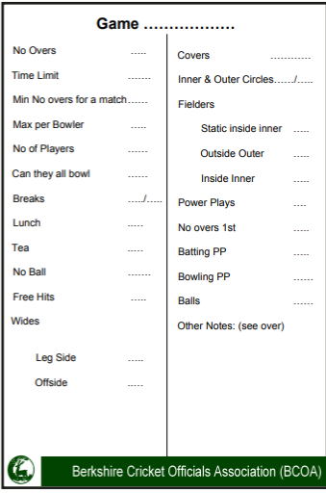
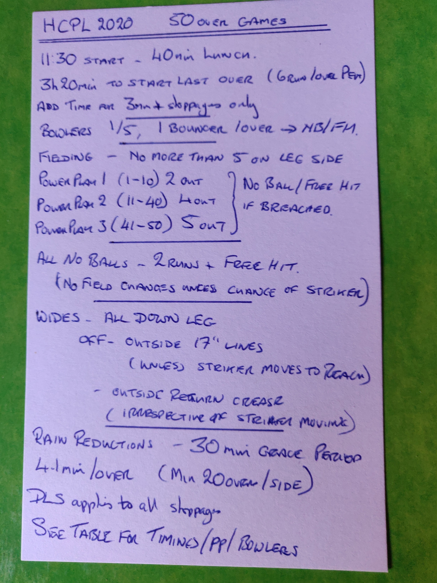
How to keep track of all these Regulations?
Here are three examples you could use, one freehand, one typed and one a blank pro forma
Press your space bar for the next slide

Slide 23
Players will forgive the odd error in decision making, the missed edge
not given caught behind or given LBW.
They are less forgiving of umpire who does not know the Regulations
Knowing the Laws is taken as a given!
Reviewing the competition regulations MUST form part of your
pre match preparation
Press your space bar for the next slide

Slide 24
Thank you for watching
For further information on all aspect of umpiring please
contact your County Association of Cricket Officials
Produced by:
Ian Royle, Regional Education Officer
Much of this presentation is based on a document provided by Middlesex ACO.
Edited by:
John Golding, Regional Development Officer

