Slide 1

Bite Sized Umpiring
Giving Decisions
Slides will build up for you
To move to next slide click your space bar
To start videos click on the image.

Slide 2
This series of short clips and slides aims to:
Jog a few memories for established umpires
To give a few tips to the less experienced
Maybe give players, and especially captains, a few ideas about what they should be looking for when they come to mark an umpire’s performance as many are asked to do on a weekly basis
Provide some food for thought and hopefully some light relief for the viewer
Press your space bar for the next slide

Slide 3
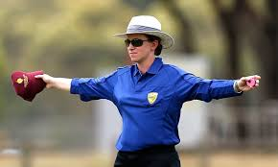
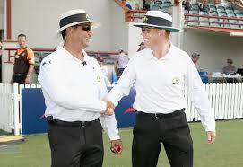
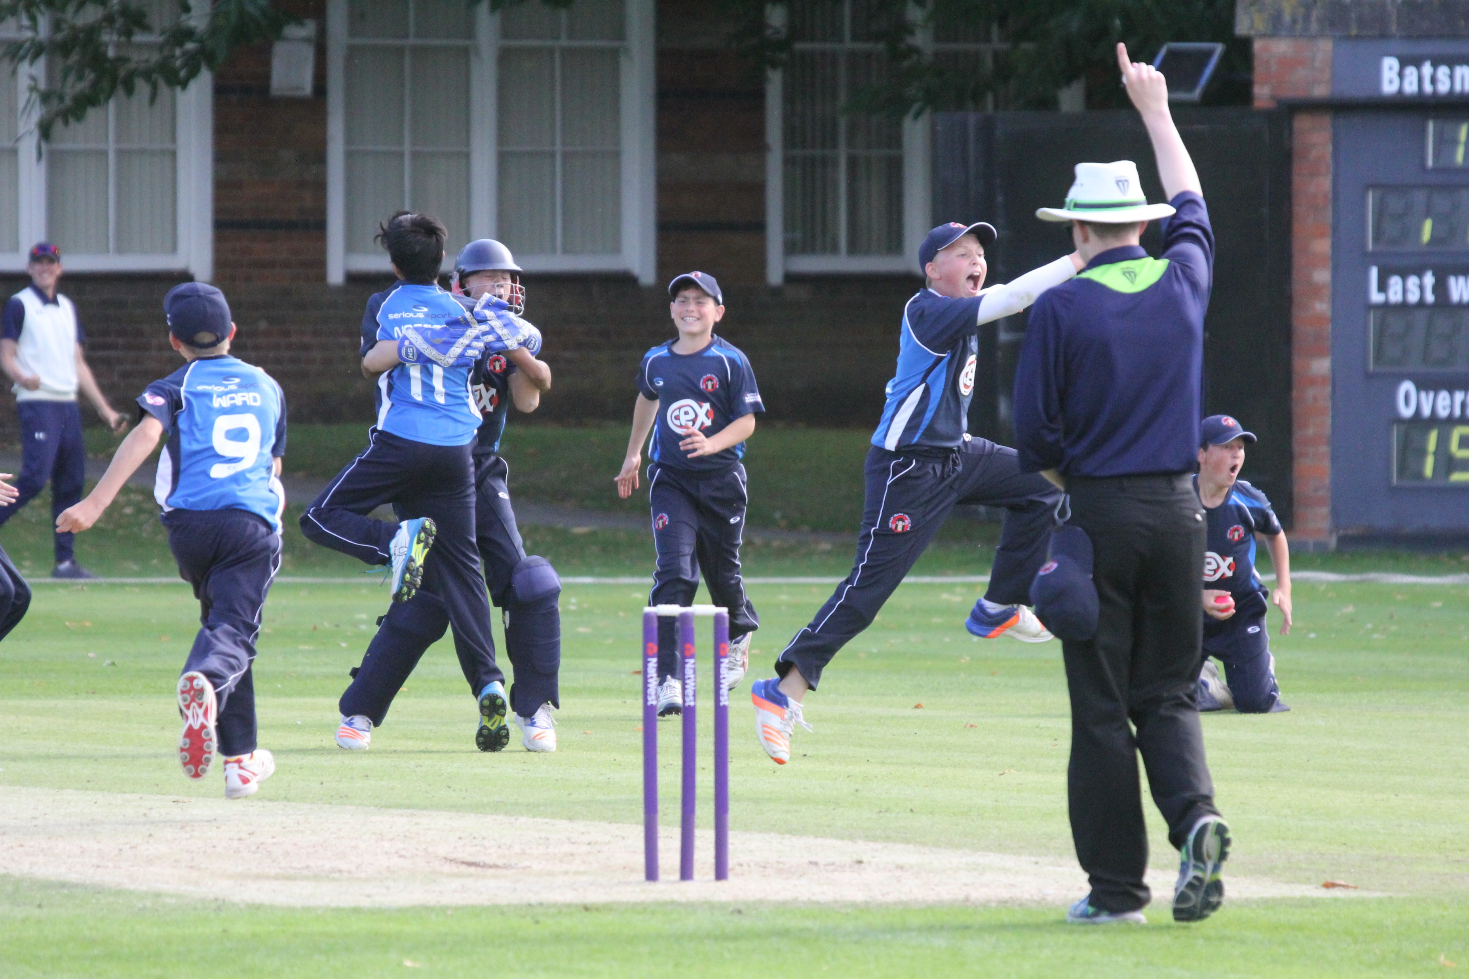
These presentations are an overview only
They will provide you with an understanding of some cricket umpiring techniques, but you will need to develop these skills through practical experience and more structured training should you wish
It won’t teach you everything you need to know, but it will give you some of the tools to start off
Press your space bar for the next slide

Slide 4
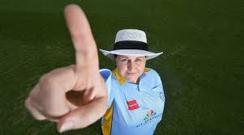
1. Giving THAT decision – Out or Not Out
Press your space bar for the next slide

Slide 5
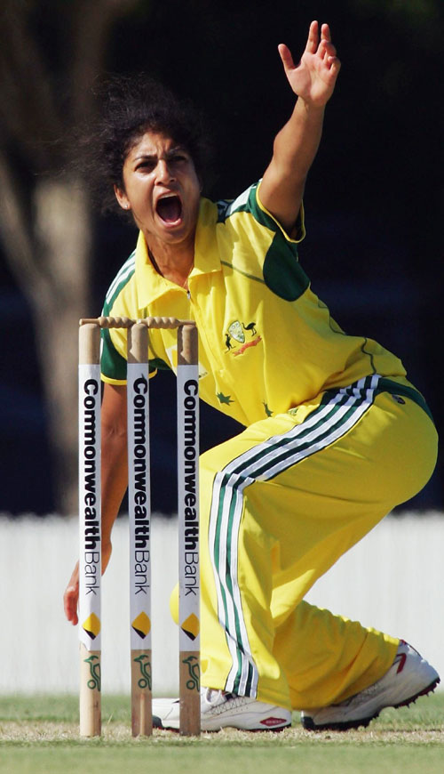
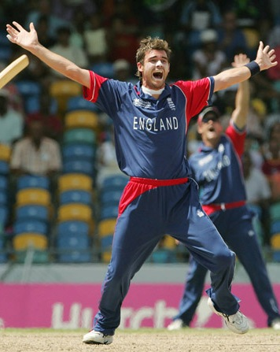
Before any decision…
There has to be an Appeal
Don’t put that finger up before
they Appeal!
Any form of “How’s that”
will do
Any appeal is aimed at both
umpires for any form of
dismissal
Press your space bar for the next slide

Slide 6
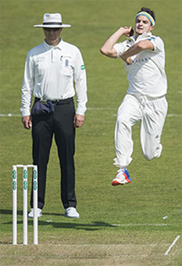
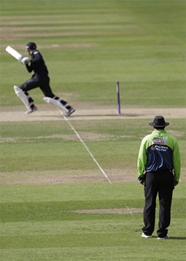
Which umpire makes which decision?
Bowler’s End
Striker’s End
1
Bowled
1
Stumped
2
Caught
3
L.B.W
2
Run Out
(at that end)
4
Run Out
5
Obstructing the field
6
Hit ball twice
3
Hit Wicket
7
Timed Out
Take a minute to think which end makes which decision – click on numbers for answers
Press your space bar for the next slide

Slide 7
Which umpire makes which decision?
Bowler’s End
Striker’s End
Which ever end you are standing at it may be
necessary to consult with your colleague over a
dismissal
For example, striker’s end may be better placed
to see if a catch carried to a slip fielder
or if there is a run out at your end with both batters
at the other end you will need to know who to give out
(see next video)
It is always best to consult over unusual
decisions such as Obstructing the field, Hit ball twice
or Timed out
Press your space bar for the next slide

Slide 8
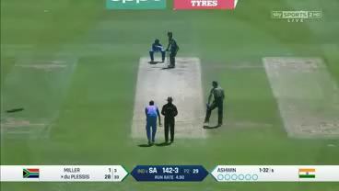
So who is out? – Bowler’s end to make decision but Striker’s end needs to tell him who is out
The batter nearest the camera is out as the ground at the keeper’s end
now belongs to the other one as he made it there first
Click to play
video
Press your space bar for the next slide

Slide 9
Tips:
Give yourself some thinking time after the appeal
Count 1, 2, 3, in your head
Replay the incident in your mind whilst counting
Give your decision
Say ‘Not out’ or raise an index finger above your head
(Please note – INDEX finger only!)
Try to avoid any display of emotion
Try not to shake or nod your head
Give equal consideration/time to Not out and Out decisions
Doing all of this lets the players know you are thinking about the decision
DON’T GET A REPUTATION AS “TRIGGER”
Press your space bar for the next slide

Slide 10
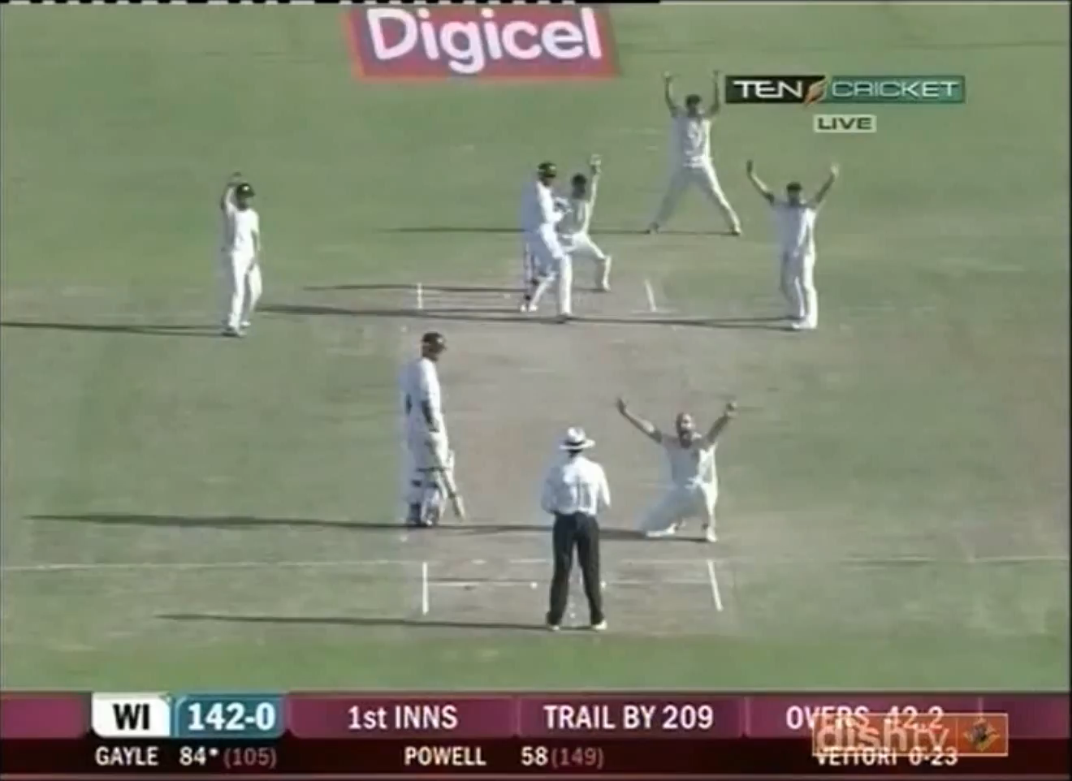
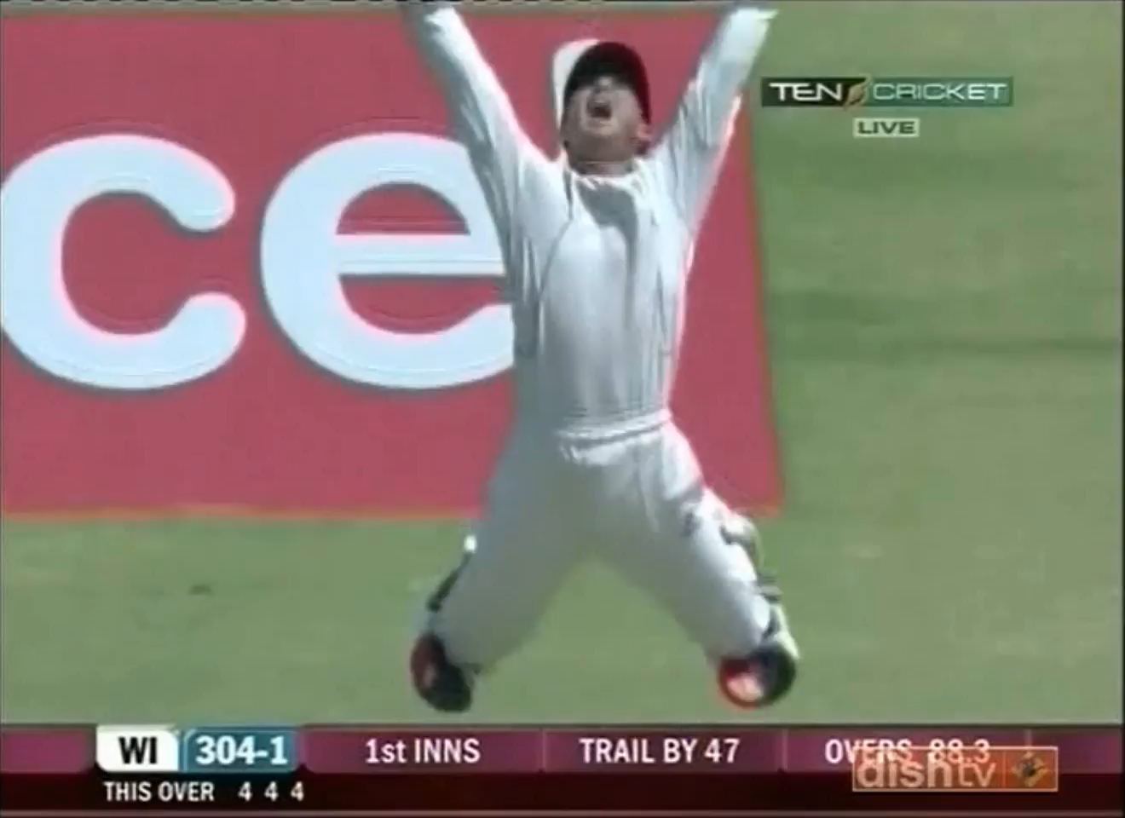
Answering Appeals
Not Out
Out
Click on videos to run
Press your space bar for the next slide

Slide 11
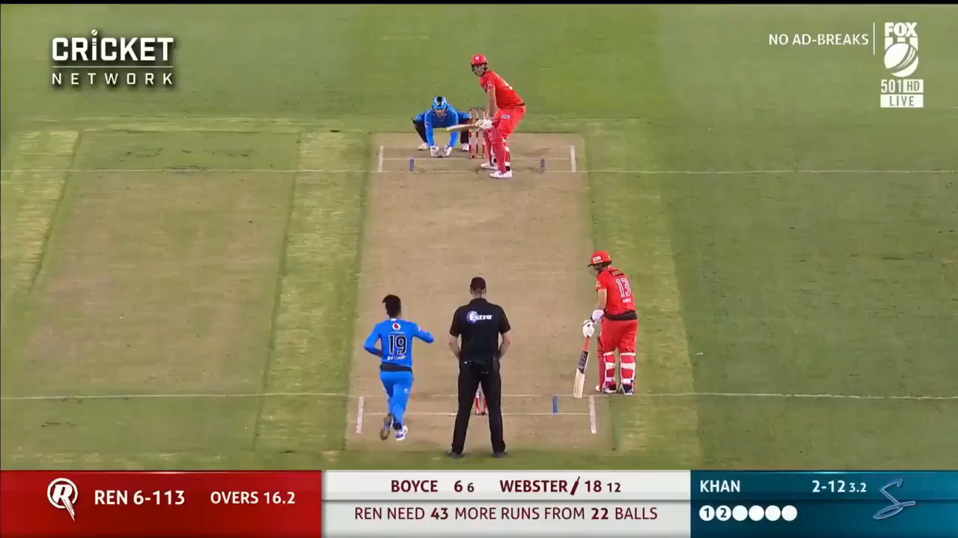
There are, of course, other ways of doing it!
Click to play
video
Press your space bar for the next slide

Slide 12
Maybe that was not the way to inspire confidence – but he got it right in the end!
Thank you for watching
Produced by:
Ian Royle, Regional Education Officer
Edited by:
John Golding, Regional Development Officer

