Slide 1

Bite Sized Umpiring
Planning and Preparation
Slides will build up for you
To move to next slide click your space bar
To start videos click next.
Disclaimer: All audio parts of this presentation are the sole property of their respective owners.

Slide 2
This series of short clips and slides aims to:
Jog a few memories for established umpires
To give a few tips to the less experienced
Maybe give players, and especially captains, a few ideas about what they should be looking for when they come to mark an umpire’s performance as many are asked to do on a weekly basis
Provide some food for thought and hopefully some light relief for the viewer
Press your space bar for the next slide

Slide 3
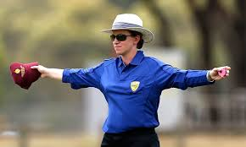
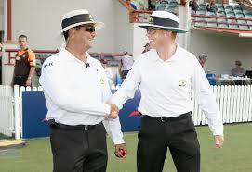
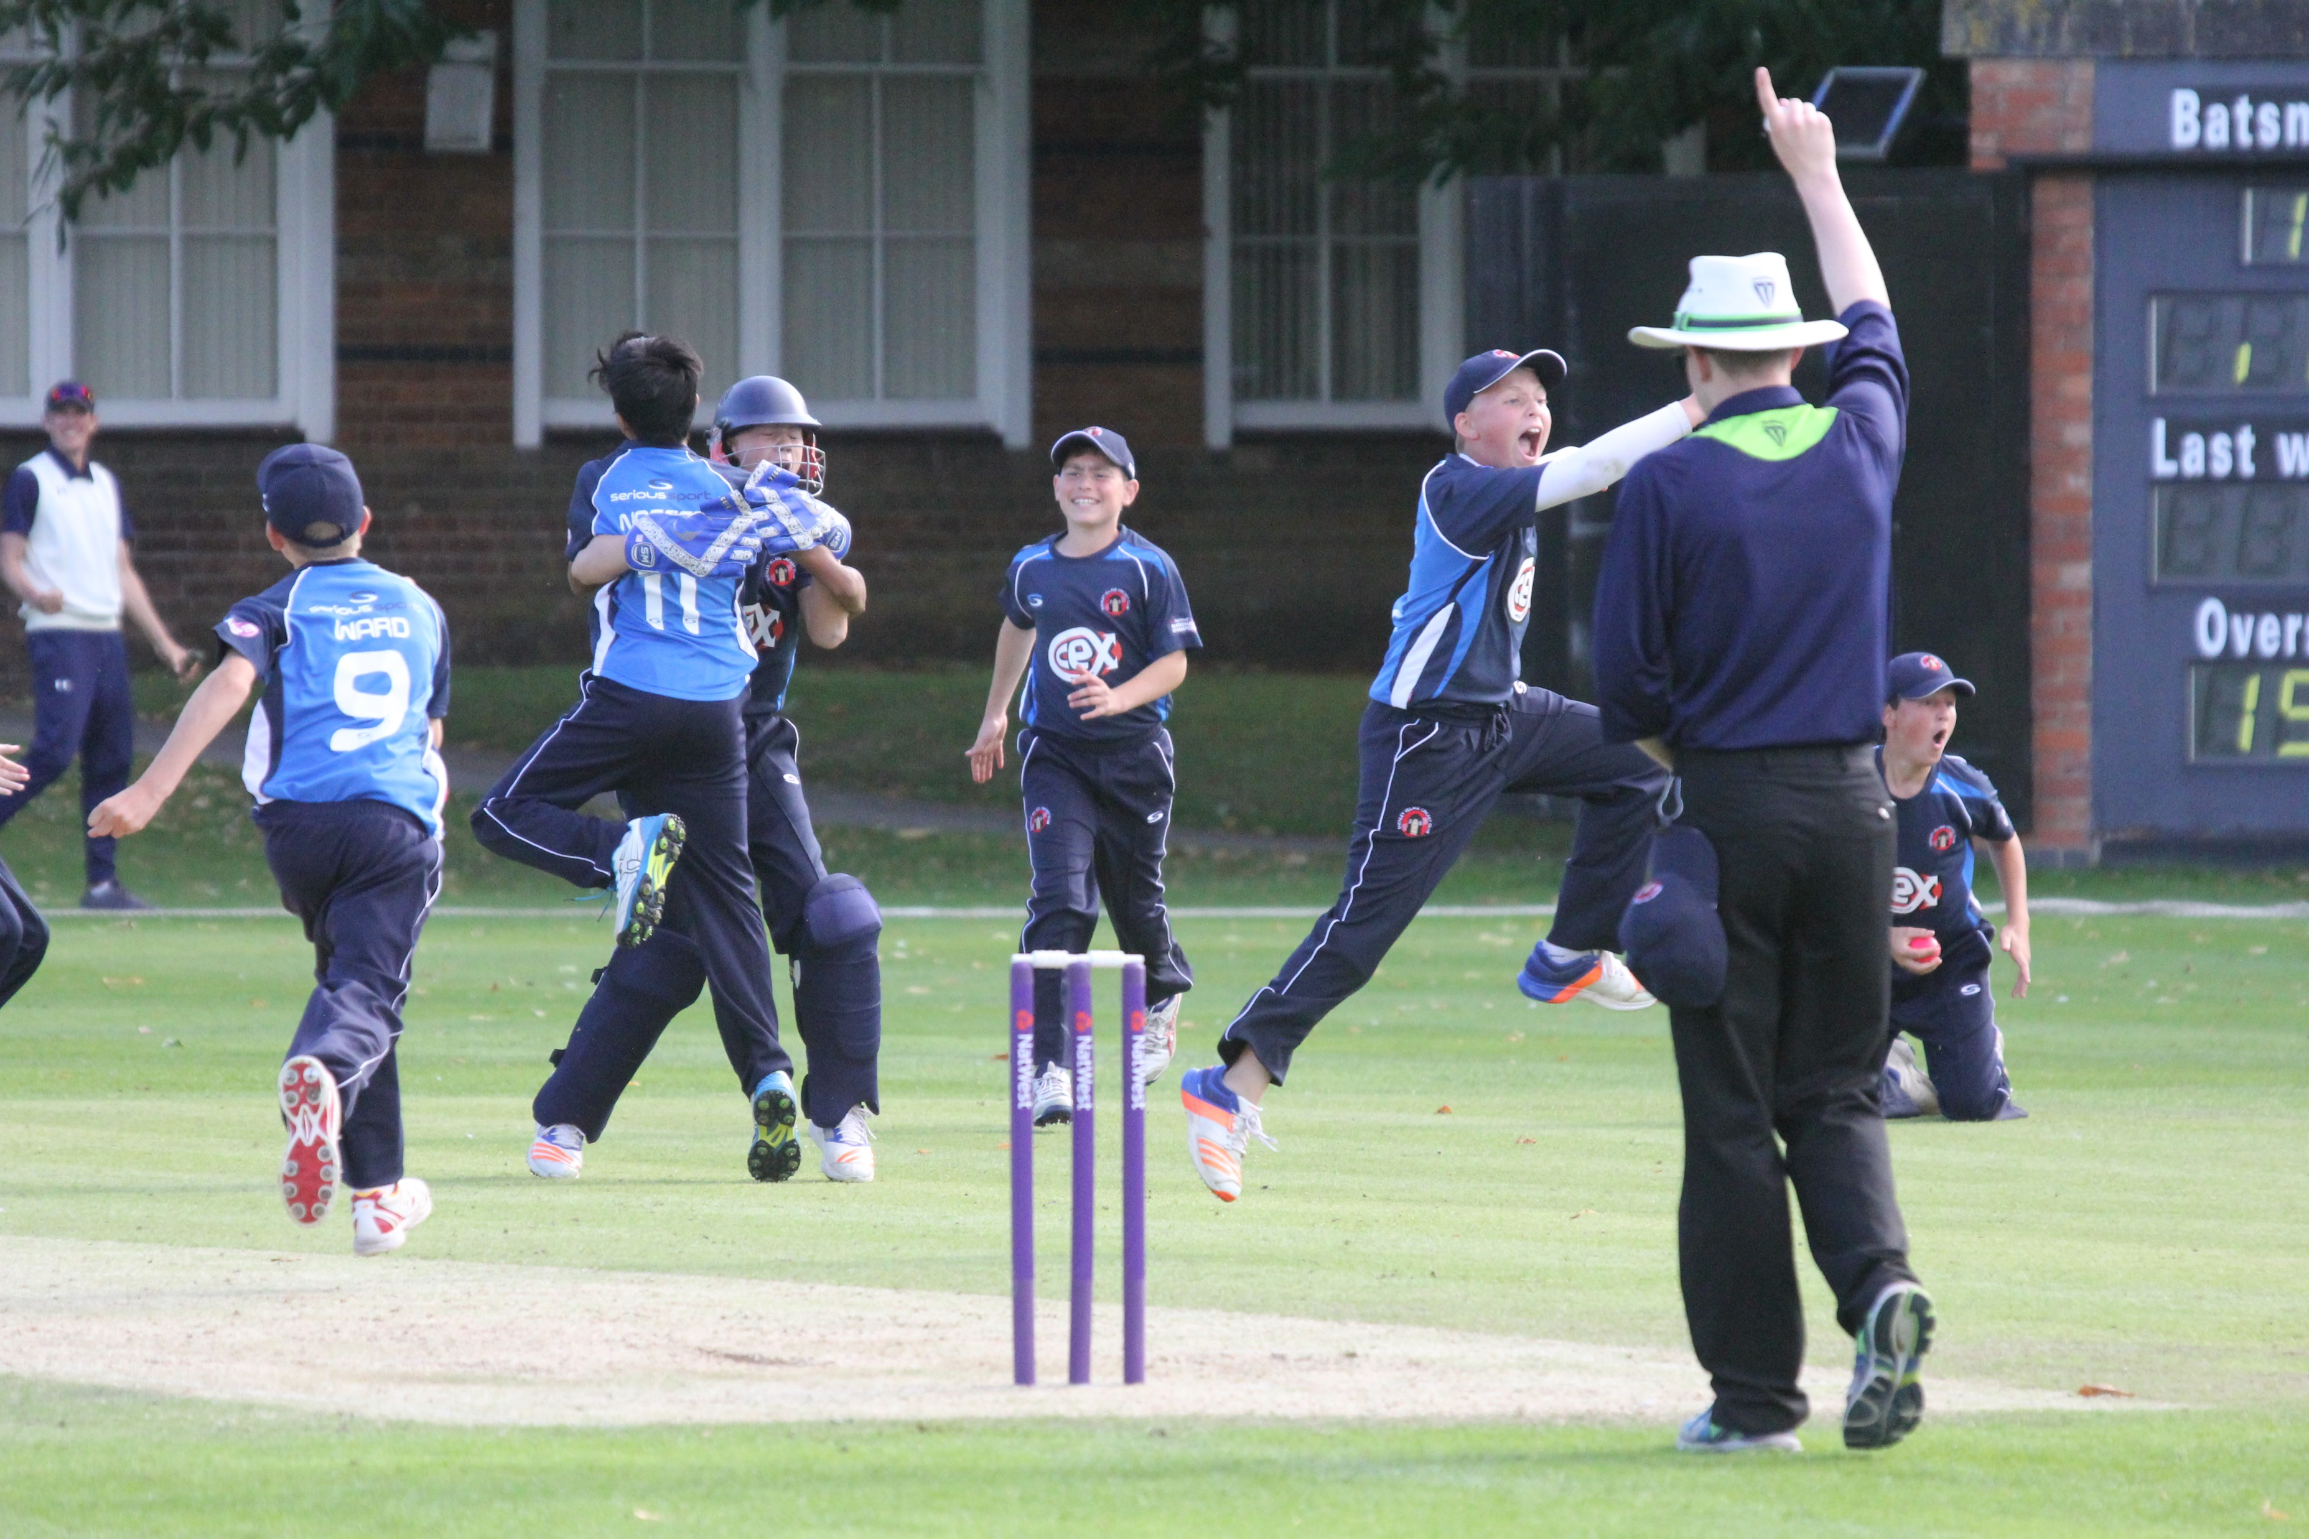
These presentations are an overview only
They will provide you with an understanding of some cricket umpiring techniques, but you will need to develop these skills through practical experience and more structured training should you wish
It won’t teach you everything you need to know, but it will give you some of the tools to start off
Press your space bar for the next slide

Slide 4
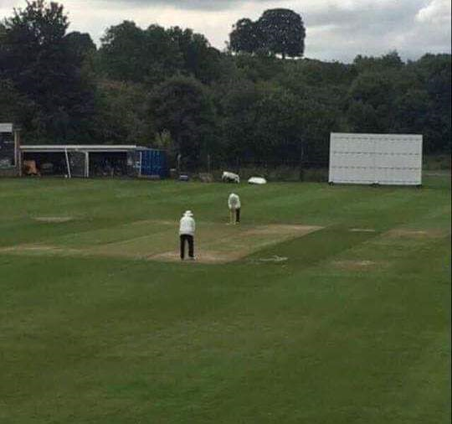
Planning &
Preparation
Prevent
Poor
Performance
(Spot the “deliberate” error)
Press your space bar for the next slide

Slide 5
Planning and Preparation
We all “do” planning and preparation in some form……
….whether we realise it or not!
The aim of this presentation is just to, hopefully, give a bit of structure to
the process.
Press your space bar for the next slide

Slide 6
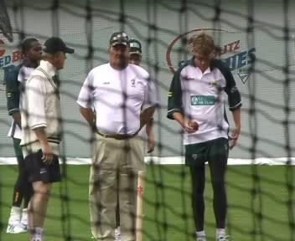
When do you start Planning & Preparation?
Ever though of attending pre-season nets?
Consolidate your strengths
Work on areas for development
Foot faults
Flight of ball
Move eyes not head
Where did it pitch?
LBW decisions
Did they edge it?
Concentration
Press your space bar for the next slide

Slide 7
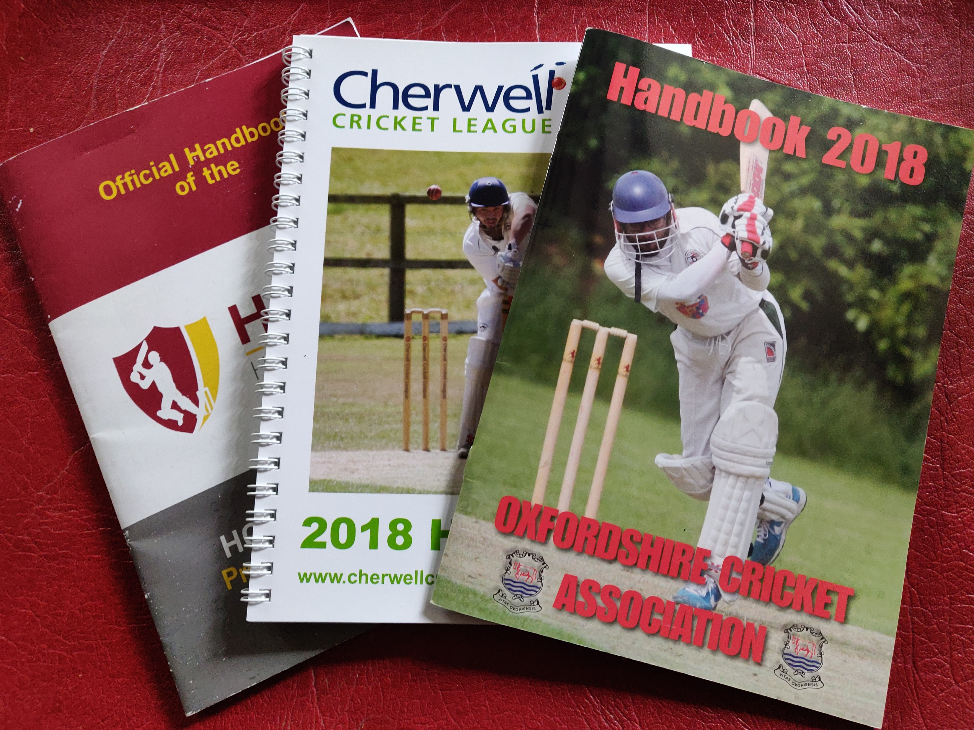
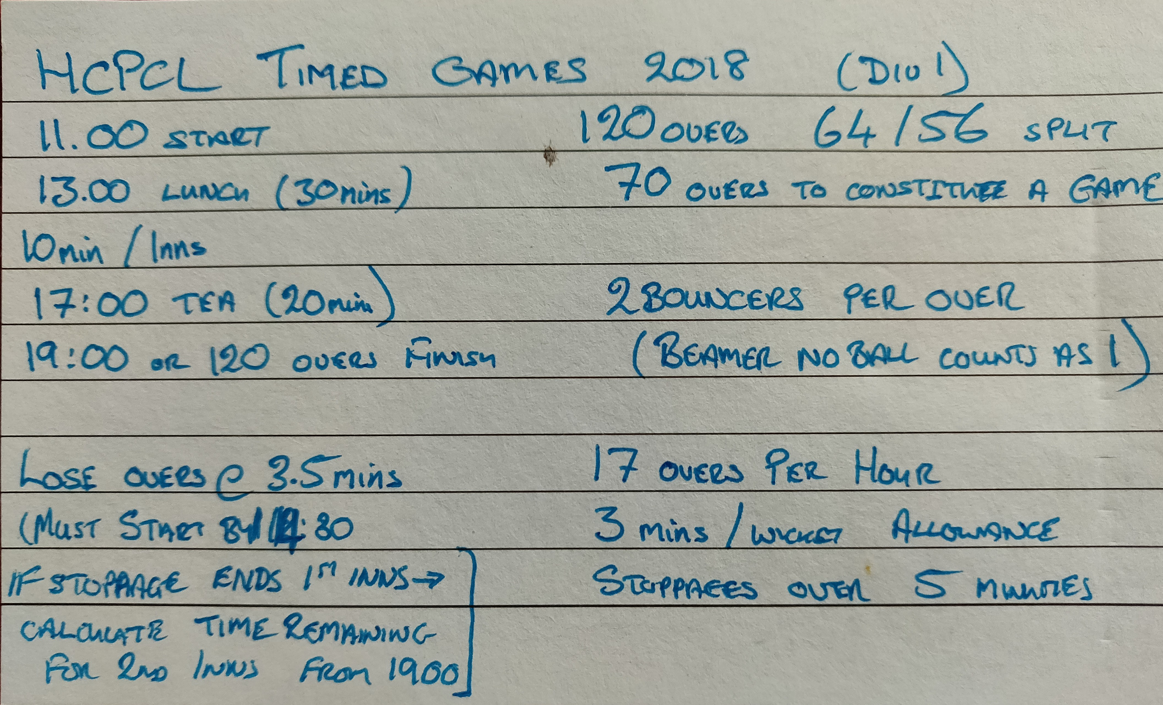
When do you start Planning & Preparation?
When you get the appointment?
What are the regulations?
Where do I find them?
These days you will probably have to find your regulations on line
Tip: - many umpires make up a small “Cheat Sheet” covering the salient points for a particular competition
Press your space bar for the next slide

Slide 8

When do you start Planning & Preparation?
When you are driving home after the game?
We’ve all done it, either by ourselves or with a colleague!
Review the game
What went well?
What do I need to work on next week?
And do it that way round!
Do not concentrate on the (perceived) errors
Look to build on what you did right!
Set some personal goals for next week
Press your space bar for the next slide

Slide 9
So, just what can you plan and prepare?
Mental and Physical Preparation
Study the competition regulations during the week
Take regular exercise – just like your doctor keeps telling you!
Get a good night’s sleep – keep away from those Friday all nighters!
Be well hydrated leading up to the game – No, not with beer and wine!
Eat well and sensibly – a decent, balanced breakfast is a must
Try to leave any external issues in the car as you arrive
“Cricket umpiring is certainly more a mental game.
I would say mentally it is 95% of what we do” – Simon Taufel 2012
Press your space bar for the next slide

Slide 10
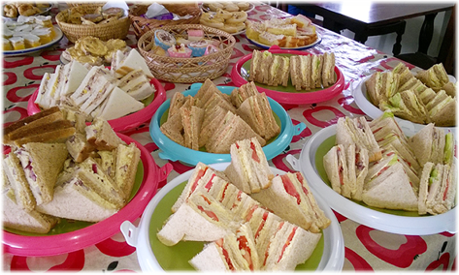
You need to understand the effect food and drink has on you as an individual but in general terms:
Varied and balanced diet → good health
Carbohydrate → energy & recovery
Adequate protein → growth & muscle
Moderate to low in fat → health
Adequate fluid → hydration
Regular meals → energy & concentration
So maybe the average cricket tea
is not the ideal snack between innings?
Audio – Chris Kelly, ECB Umpires’ Manager
Press your space bar for the next slide

Slide 11
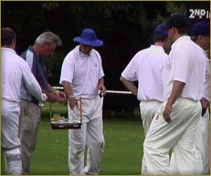
Fluid Replacement
Drink regularly
Thirst is a poor indicator of needs
Dehydration of only 1% of body weight can decrease performance
Start each session well hydrated
Replace fluids during and after each session
You need to work out your own balance between not dehydrating and losing
concentration………
and losing concentration because you need to pee!
Press your space bar for the next slide

Slide 12
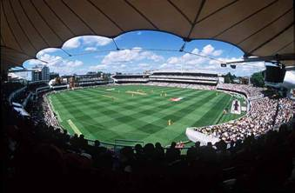


Journey Planning
Know where you are going!
Plan your journey to the ground in advance
Route
Time
Allow for delays
All of this to ensure you are not in a
rush when you arrive at the ground –
Rushed = Stressed = Poor Performance
Press your space bar for the next slide

Slide 13
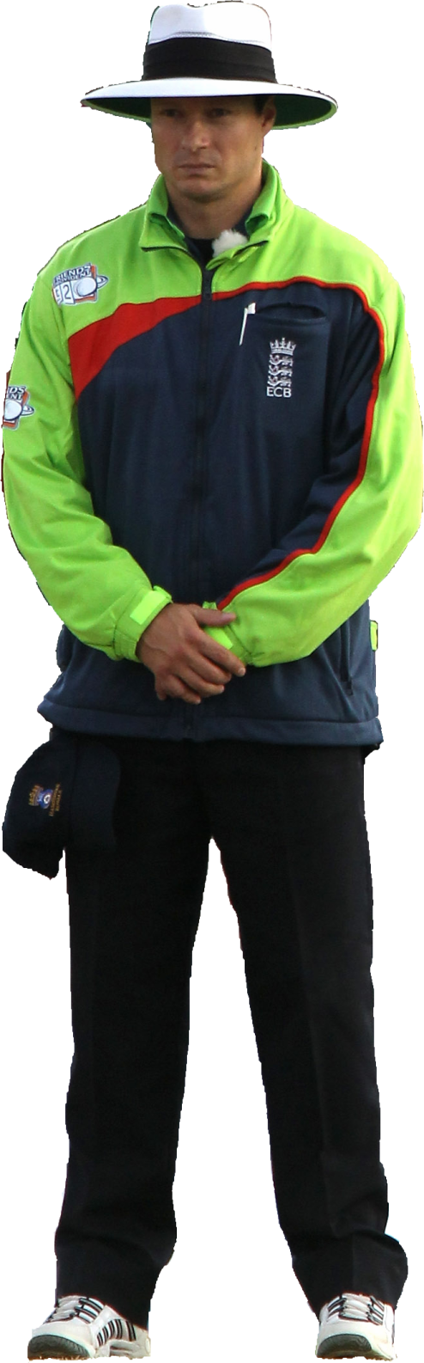
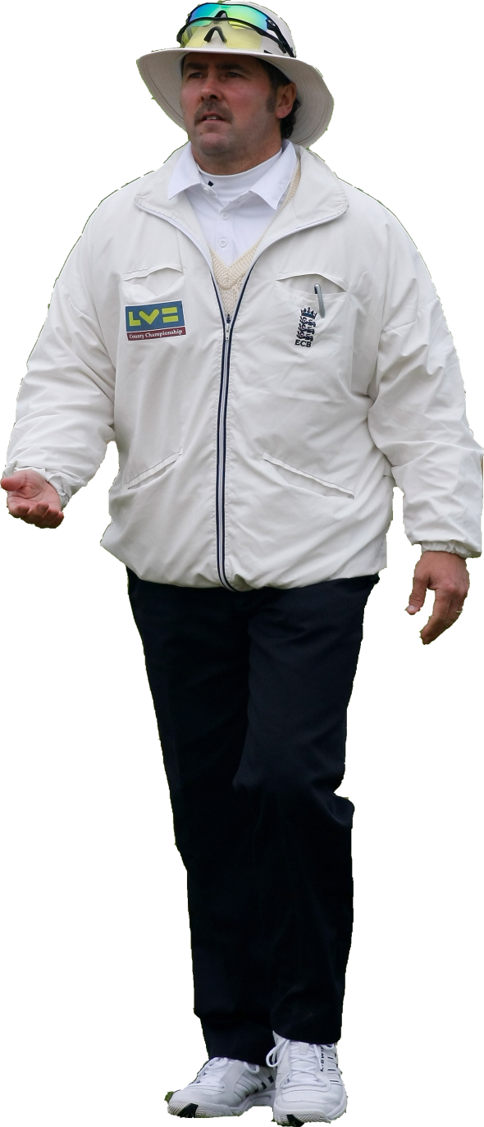
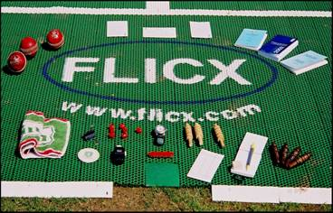
Kit Preparation
Right clothing for this competition – whites or colours?
Is it clean?
Does my colleague have the same style of kit?
– possibly ring them?
Do I have all the “bits” – did I lose anything last week?
Pack your bag a least a day in advance to check it all
Hands up – who’s turned up at a game to find they haven’t got their shoes/shirt/socks/hat? – you only do it once… (a season!)
Press your space bar for the next slide

Slide 14

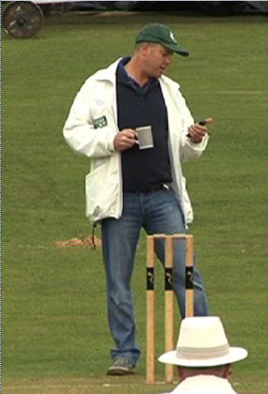
Once you arrive at the ground – Pre Match Preparation
Remember –
You don’t get a second chance to make a first impression
Arrive looking reasonably smart – (possibly ACO leisure kit – we are not on commission!)
Change into your field kit, minus jacket, before you start to walk around
What impression do you want to create?
Press your space bar for the next slide

Slide 15
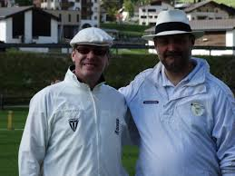
Once you arrive at the ground – Pre Match Preparation
Find your colleague – you need to discuss:
Any strange regulations
Agree on wides if not stipulated
Signals between the two of you – balls to go/height of beamers & bouncers
Crossing for right and left handers
How you will deal with weather problems (if it looks like rain)
Timings – who’s watch if there is no clock
What you will say to captains at the toss – share it out
Press your space bar for the next slide

Slide 16
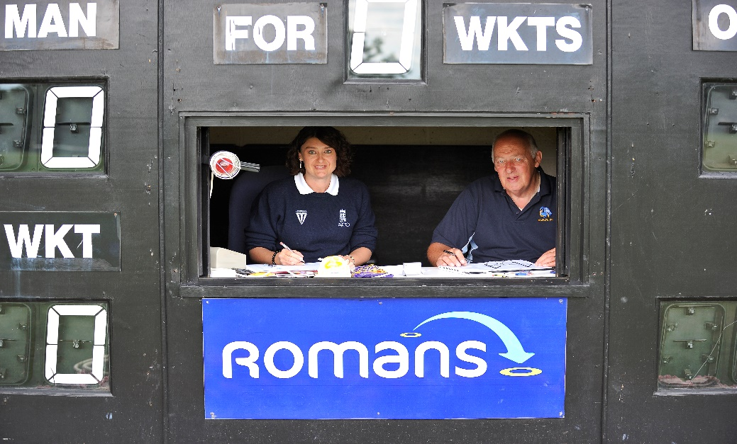
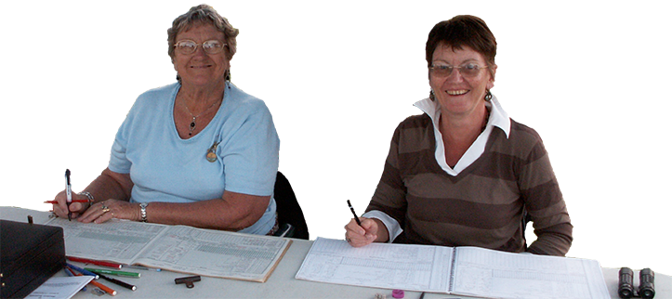
Once you arrive at the ground – Pre Match Preparation
b) Find the scorers (if you are lucky enough to have them)
Where will they be sitting?
How will they acknowledge signals?
Any oddities in the regulations e.g. 2 for a No ball
Are they happy to do the scoreboard or do we chase the captains?
Timings and which clock you are using
Will they look after the spare balls?
Have they got team sheets?
Do they know all of their players?
Press your space bar for the next slide

Slide 17
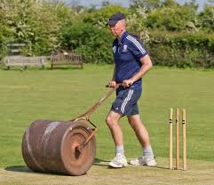
Once you arrive at the ground – Pre Match Preparation
c) Meet the groundsman – again – lucky you if there is one
Local knowledge
Where does the weather come from?
Will they be there all day?
Have they got a rain radar on his phone?
Are there covers/sawdust?
Who will put covers on if needed?
How quickly does the pitch dry?
Do regulations require rolling/remarking between innings?
Press your space bar for the next slide

Slide 18
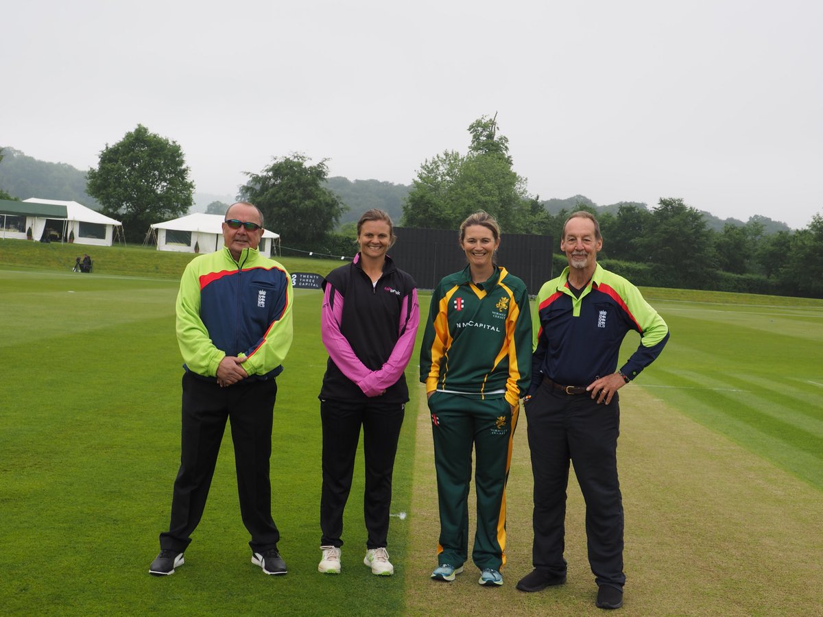
Once you arrive at the ground – Pre Match Preparation
d) Meet the captains – hopefully there will be at least 2 of them!
Get the team sheets
Identify any age group players
Find out any “local rules” from the home captain
Sort out scorers/scoreboard if necessary
Get match balls and spares
Ask they be ready to move covers if necessary
Press your space bar for the next slide

Slide 19
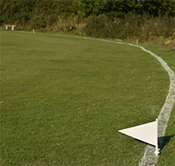
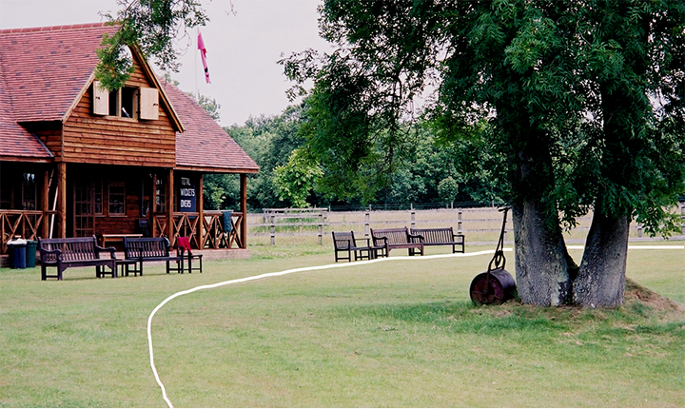
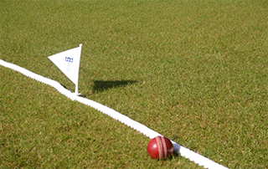
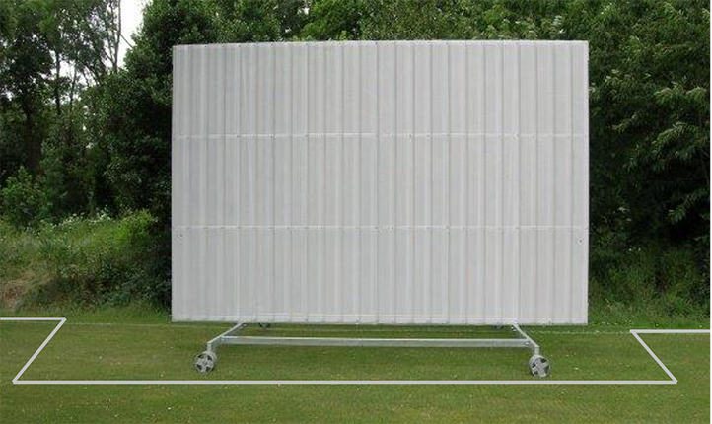
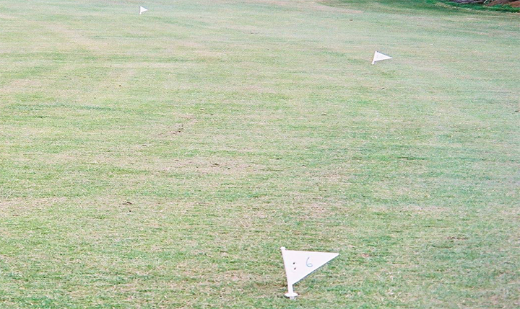
Once you arrive at the ground – Pre Match Preparation
e) Ground inspection – even if you have been there already this season
Boundaries and any anomalies – trees, no line painted
Possible hazards inside and outside of the boundary
Sight screen positions – outside boundary and space to move
Pitch markings
Stumps
Press your space bar for the next slide

Slide 20
Once you arrive at the ground – Pre Match Preparation
Visualisation
As you walk the ground you will often see batters on the pitch playing imaginary shots
As you inspect the pitch could you not do the same?
Stand in your normal bowler’s end position
Are there any useful lines in the grass to guide me – leg stump/off stump?
Play a couple of balls through in your mind
Bowler running in/delivering/appealing
Helps to set the mind up for that first ball of the day
Press your space bar for the next slide

Slide 21
So what is Visualisation?
When you imagine performing a task, you condition your neural pathways so that the action feels familiar when you go to perform it.
It’s as if you’re carving a groove in your nervous system.
On a purely psychological level, envisioning success can enhance motivation and confidence.
Envisioning calmness may also decrease physical symptoms of stress, like an increase in heart rate or stress hormones.
Press your space bar for the next slide

Slide 22

Click on video to play
Press your space bar for the next slide

Slide 23
Once you arrive at the ground – Pre Match Preparation
f) Conducting the Toss – with BOTH umpires present
The ECB ACO “Best Practice” policy has a long list of things they suggest you mention to the captains at the toss
If every umpire goes through that list every week they are going to be really brassed off by half way through the season
Choose what you need to say depending on the conditions
Share out who says what so it does not look like one umpire is “in charge”
Press your space bar for the next slide

Slide 24
f) Conducting the Toss – with BOTH umpires present
Use questions to get agreement – not statements to dictate:
“You remember you are responsible for the conduct of yourselves and your players don’t you?”
“Are you both happy you know and understand the playing regulations for today?”
“When do you want drinks today?”
“You know you are responsible for your over rates but do you want us to give you a countdown on time remaining?”
Press your space bar for the next slide

Slide 25
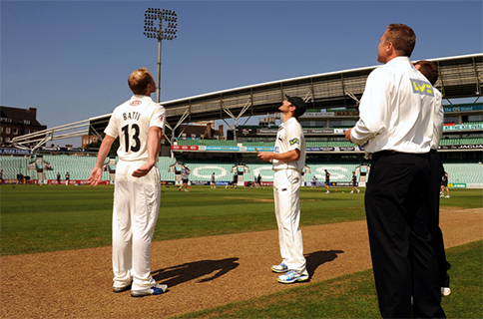
f) Conducting the Toss – with BOTH umpires present
By using this approach, if there is a problem later then your response to the captains is:
“You told me at the toss that you………XYZ”
Conduct the toss (and make sure you get your coin back!)
Get an immediate response as to who is batting/bowling
Let the scorers know the outcome
Press your space bar for the next slide

Slide 26
Once you arrive at the ground – Pre Match Preparation
g) After the toss
You should have a few minutes to prepare yourself for the start of the game
Decide with your colleague which ends you will take
Drink if you need it
Toilet!
Check your pockets!
Ring the 5 minute bell (or knock on the changing rooms to let the teams know you are on your way out – don’t be stood out in the middle waiting for them past the start time!)
Cross the boundary, shake hands with your colleague and have a good game!
Press your space bar for the next slide

Slide 27
5. The Five Minute Drill – what to do when you get out there
Take a few minutes to build your own list and then click the numbers to check off your list against ours
1
Build wicket and align with colleague
8
Check fielding captain has set his field
2
Find out which end bowling will start from
9
Check scorers are ready
10
Check batters are ready
3
Ask for bowler’s action
11
Check colleague is ready
4
Give bowler a marker and the ball
12
Check start time has been reached
5
Notify striker of bowler’s action and
give guard
Call PLAY
13
6
Help striker to align sight screens
7
Check 11 fielders are present
Press your space bar for the next slide

Slide 28
Congratulations – your game is now underway!
All of this is to try and solve problems before they arise
Fail to Prepare – Prepare to Fail
Thank you for watching
Produced by:
Ian Royle, Regional Education Officer
Audio by:
Chris Kelly, ECB Umpires’ Manager
Disclaimer: All audio parts of this presentation are the sole property of their respective owners.
Edited by:
John Golding, Regional Development Officer

