Slide 1

Bite Sized Umpiring
Positioning
Slides will build up for you
To move to next slide click your space bar

Slide 2
This series of short clips and slides aims to:
Jog a few memories for established umpires
To give a few tips to the less experienced
Maybe give players, and especially captains, a few ideas about
what they should be looking for when they come to mark an
umpire’s performance as many are asked to do on a weekly basis
Provide some food for thought and hopefully some light relief for the viewer
Press your space bar for the next slide

Slide 3
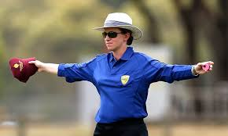
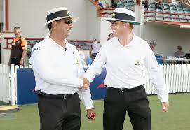
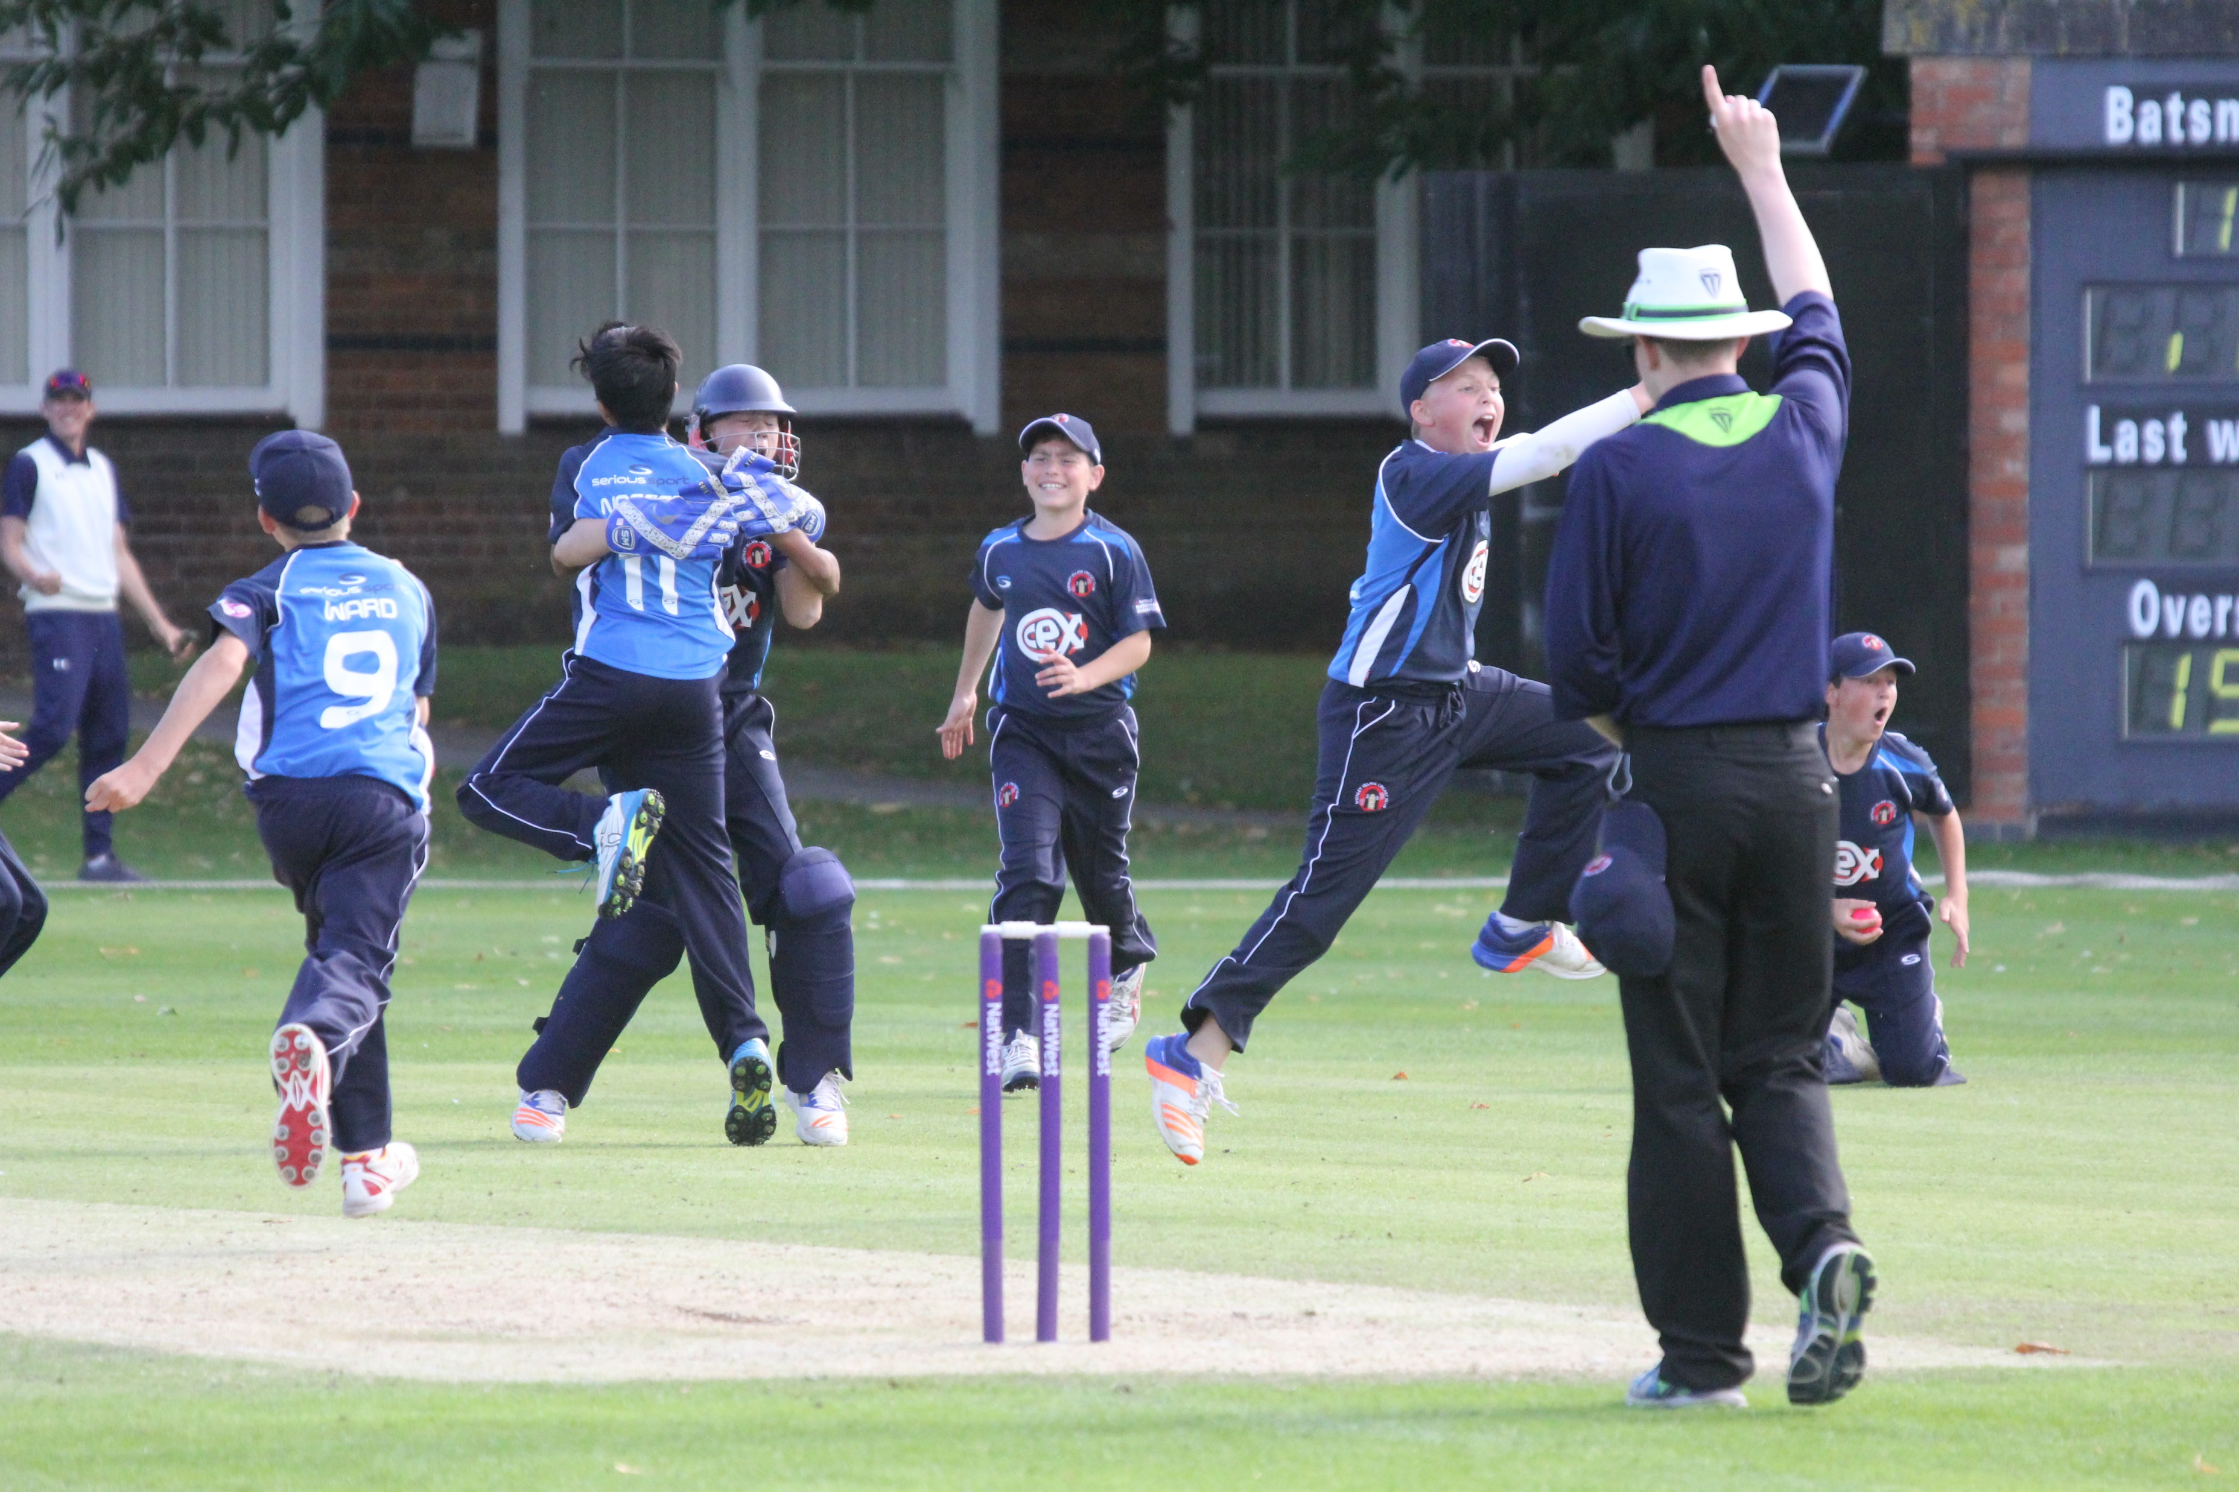
These presentations are an overview only
They will provide you with an understanding of some cricket umpiring techniques, but you will need to develop these skills through practical experience and more structured training should you wish
It won’t teach you everything you need to know, but it will give you some of the tools to start off
Press your space bar for the next slide

Slide 4
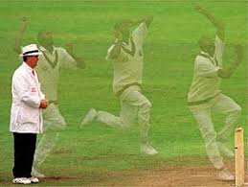
2. Positioning – where to stand
Press your space bar for the next slide

Slide 5
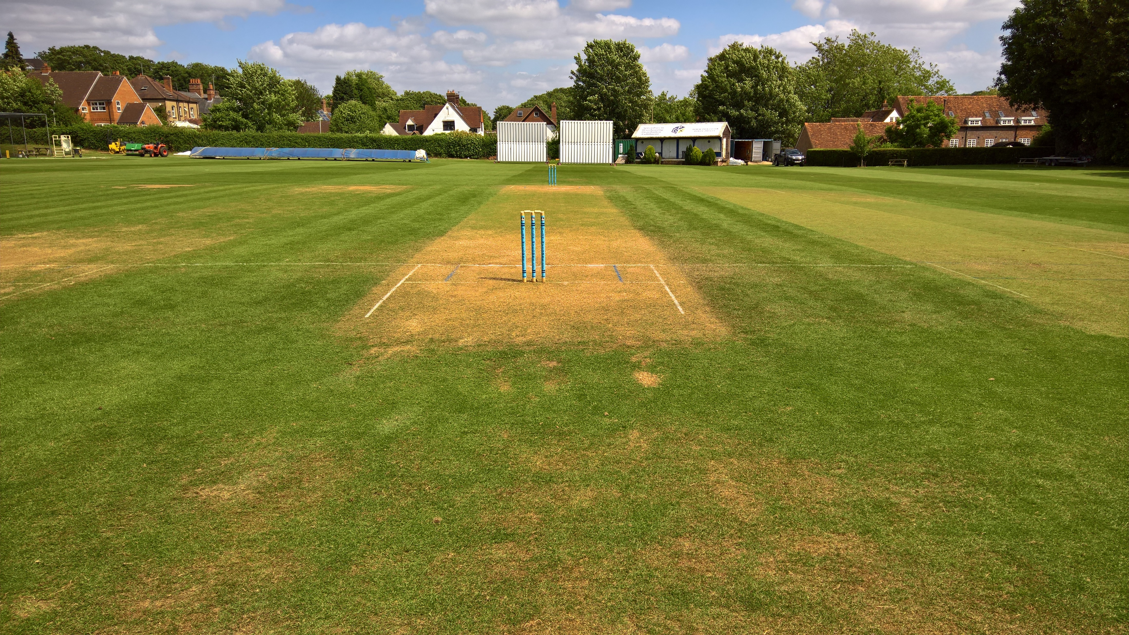
There’s plenty of ground to choose from!
Press your space bar for the next slide

Slide 6
One umpire stands at the bowler’s end and one at the striker’s end. (…and there’s a fine for anyone who says “square leg” from now on!)
It is vital that they position themselves to maximise the safety of themselves and the players
Umpires stand where they can best see and act on anything which will need a decision
Press your space bar for the next slide

Slide 7
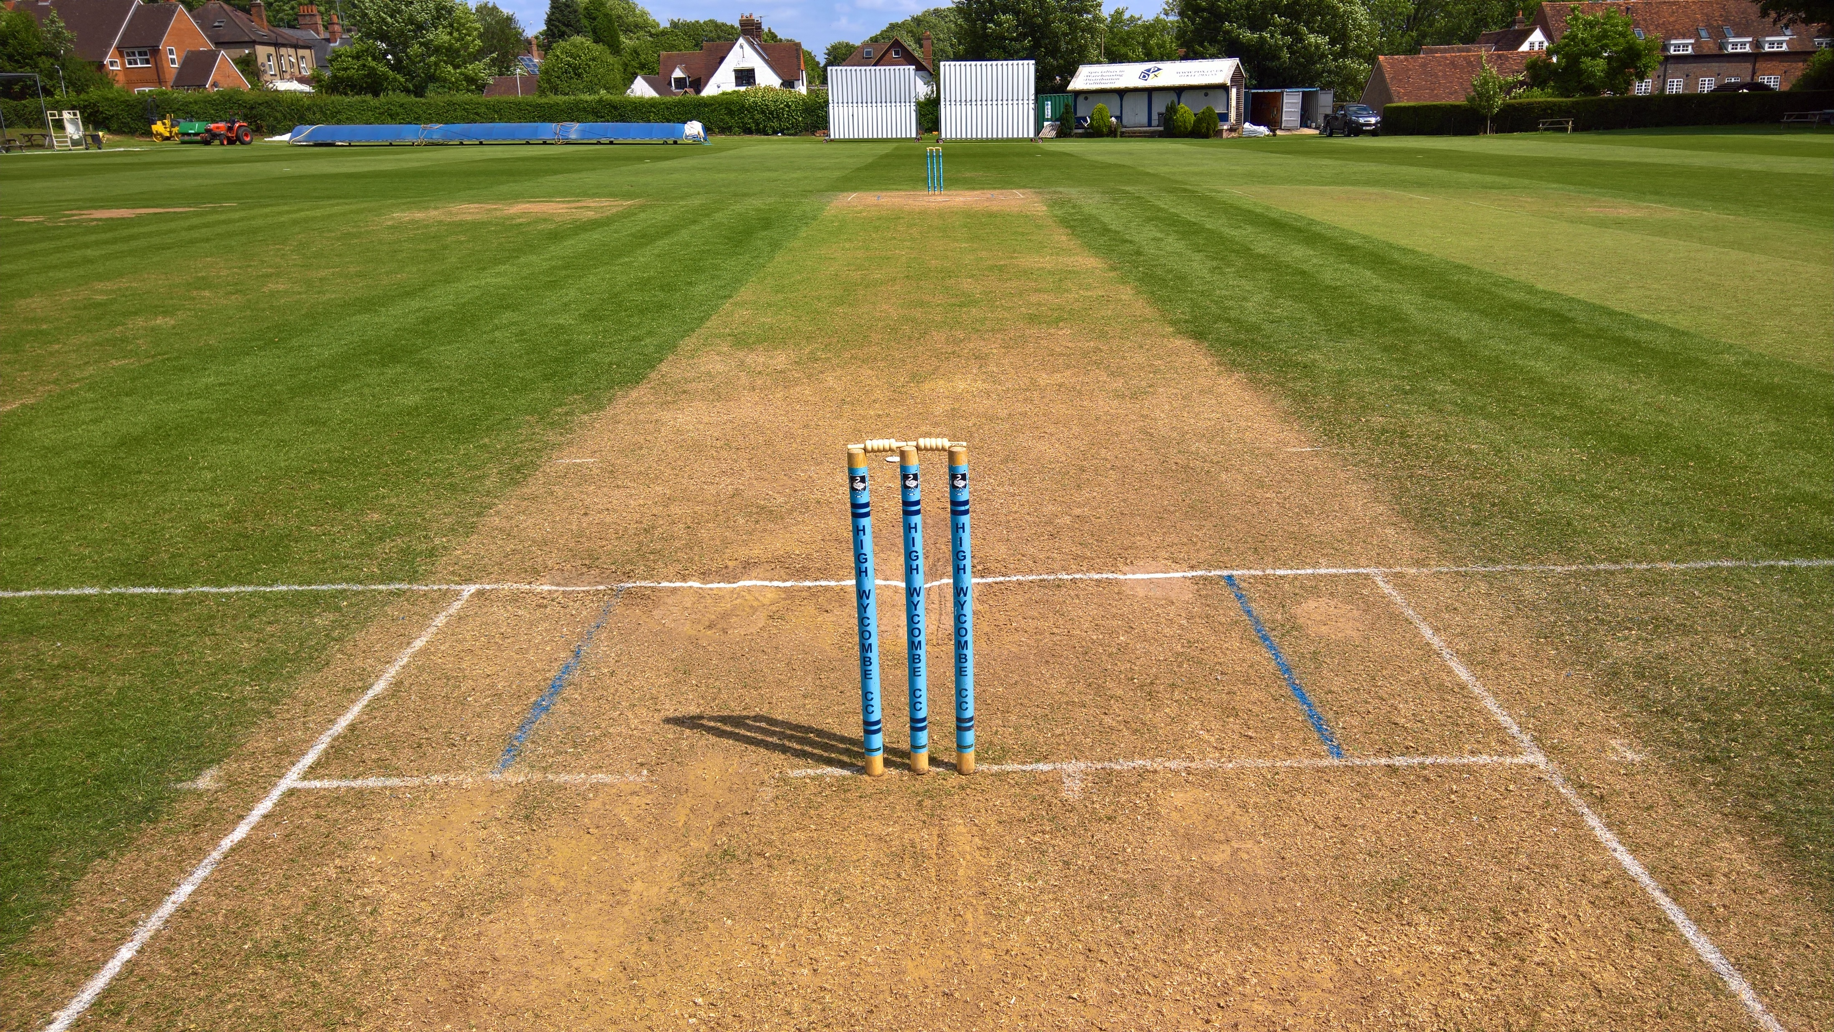
Bowler’s End
A rough guide to a
starting point
Place a bail or marker on the
5 ft line (start of the
Protected area)
Take a line from there through the top of the stumps to your eyes
Press your space bar for the next slide

Slide 8
What are the
Pros and Cons of this?
Press your space bar for next slide

Slide 9
What are the Pros and Cons of this?
You get an indication of the bowler getting into the Protected Area if you can see their feet above the top of the stumps.
(With your peripheral vision as you concentrate on the ball in flight)
Depending on your height you may not feel comfortable here
It could feel too close or too far back
This is just a suggestion – stand where you feel most comfortable
Press your space bar for the next slide

Slide 10
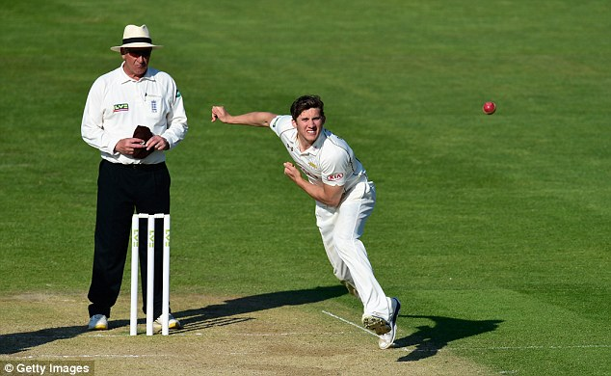
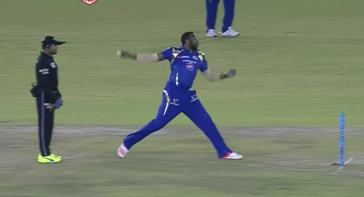
Be comfortable behind the stumps in order to;
See the bowler’s feet in his delivery stride with little or no head movement
See the line of the ball after it leaves the bowler’s hand
See the ball pitch and reach the striker
Too close
Too far back
Press your space bar for the next slide

Slide 11
A bowler, usually a spinner, might ask you to stand right up to the stumps.
What are the possible problems with this?
You can’t see their feet and then pick up the flight
of the ball without moving your head.
You are very close to the action if the ball gets
belted straight back at you!
Press your space bar for the next slide

Slide 12
If a bowler (usually a quicker bowler) asks you to stand further back?
Usually means:
They have a No ball problem and wants you so far back you can’t see!
OR
They have a tendency to smack the umpire in the back as they run through!
Or in the case of the picture they want to bowl from well behind the stumps to try to confuse the striker!
Press your space bar for the next slide

Slide 13
In either case if the bowler asks you to stand in a particular position then do so provided you can still see everything you need to see and feel safe.
Otherwise politely decline their request and explain why
Press your space bar for next slide

Slide 14
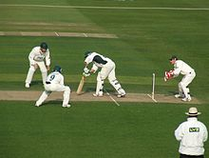
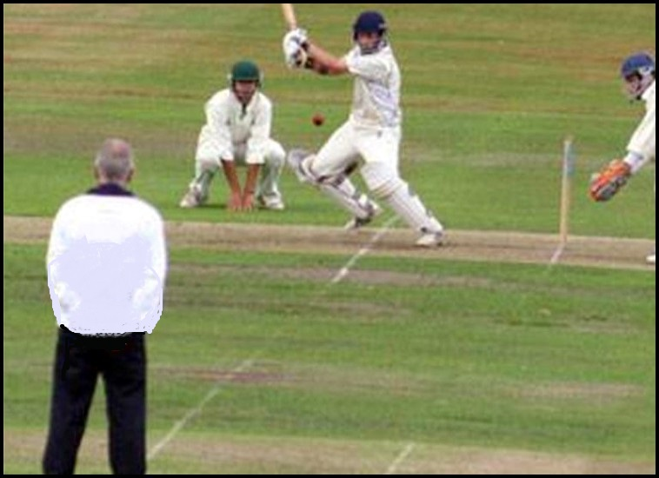
Positioning – striker’s end
Must stand in line with the popping crease (in order to judge stumpings, hit wicket or run outs) either at;
or
Square Leg
Point
Press your space bar for the next slide

Slide 15
Convention is that you stand at Square Leg
However, you may choose to stand at point:
If the sun is in your eyes
The popping crease has rubbed out on one side
A fielder wishes to stand in line
The ground contours mean you cannot see the line from one side
Square Leg
Do not cross over for left & right hand batters if this is going to waste time
Press your space bar for the next slide

Slide 16
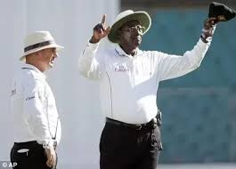
On TV, umpires may not stand in line with the popping crease – this is so that they do not obstruct the view of the cameras for the third umpire .
When you get cameras and a third umpire at your games you can do the same – until them stand in line with the popping crease!!
Press your space bar for the next slide

Slide 17
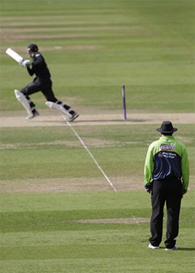
Striker’s End
At Bowler’s end you will be about 25 yards away
from the action
So why not the same distance at Striker’s end?
It means your eyes are working at the same focal
distance both ends
Press your space bar for the next slide

Slide 18
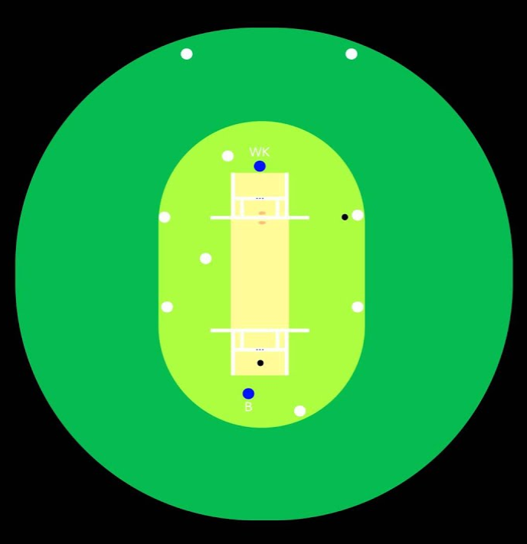
If you have a fielding circle to manage you may
consider moving out a bit further to the edge of the
circle to keep all of the players in view
Conversely, if you think there is a bit of untoward
chat going on between keeper and striker you
might want to move in a bit closer to eavesdrop
on the conversation!
Press your space bar for the next slide

Slide 19
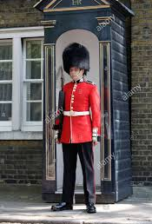
How do you stand?
Legs stiff, knees locked?
Not good for your back
Not good for a quick getaway!
Weight tends to be on your heels
Press your space bar for the next slide

Slide 20
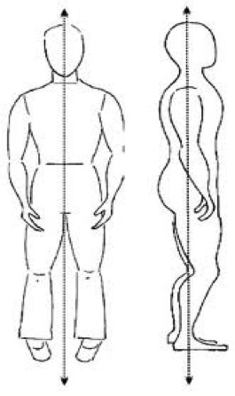
Maybe try this out?
Knees slightly flexed
More relaxed posture
Weight is more evenly distributed through feet
Enables quicker initial movement
From Tai Chi/Qi Gong practice
Press your space bar for the next slide

Slide 21
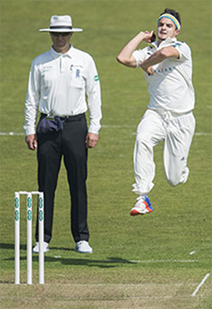
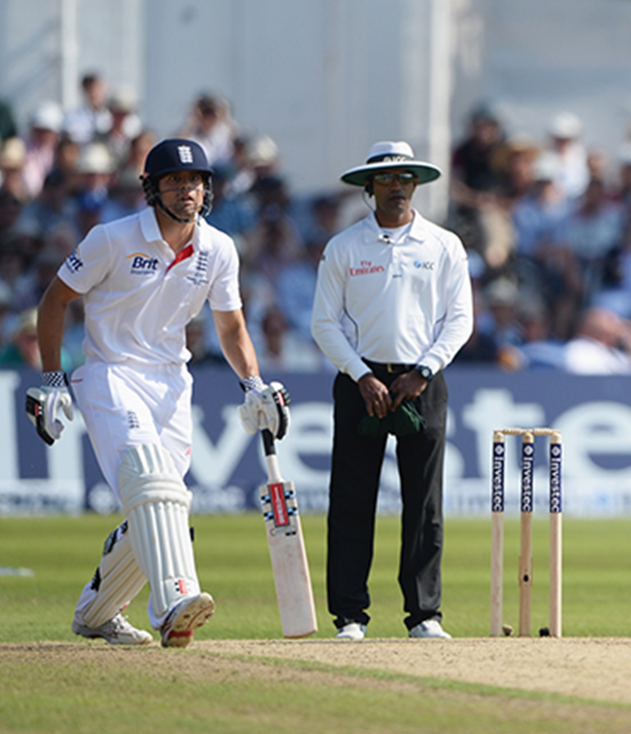
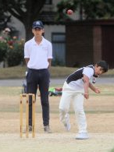
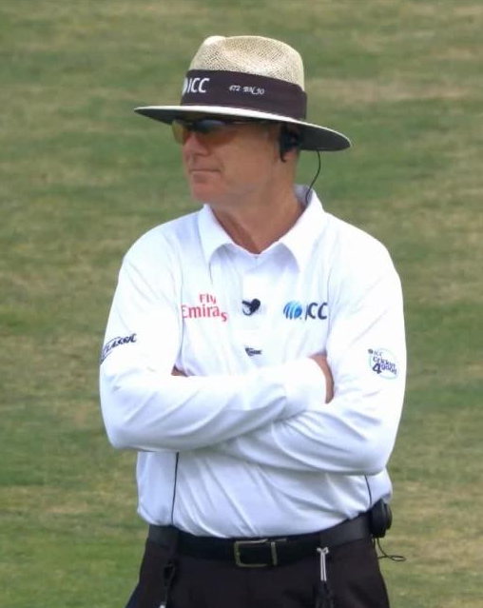
What do you do with your hands?
By your sides
In front of you
NOT behind
your back
NOT folded
Press your space bar for the next slide

Slide 22
What do you do with your hands? – WHY?
Safety!! – you need to be able to move your hands quickly to protect yourself.
(So preferably you should not be holding anything Kumar!)
By your sides
In front of you
Press your space bar for the next slide

Slide 23
What do you do with your hands?
These two might be in a bit of trouble with a ball hit straight back at them
It also doesn’t look very good body language wise Mr Gaffney
NOT behind
your back
NOT folded
Press your space bar for the next slide

Slide 24
The next module, Movement and Positioning,
covers movement from these static positions
Thank you for your attention
Produced by:
Ian Royle, Regional Education Officer
Edited by:
John Golding, Regional Development Officer

